Slide 1
American International University-Bangladesh (AIUB) Department of Computer Science (Spring 2024-25) Human Computer Interaction
Presented By
Name: Rifah Sanzida Id: 22-47154-1
Section: C

Slide 2
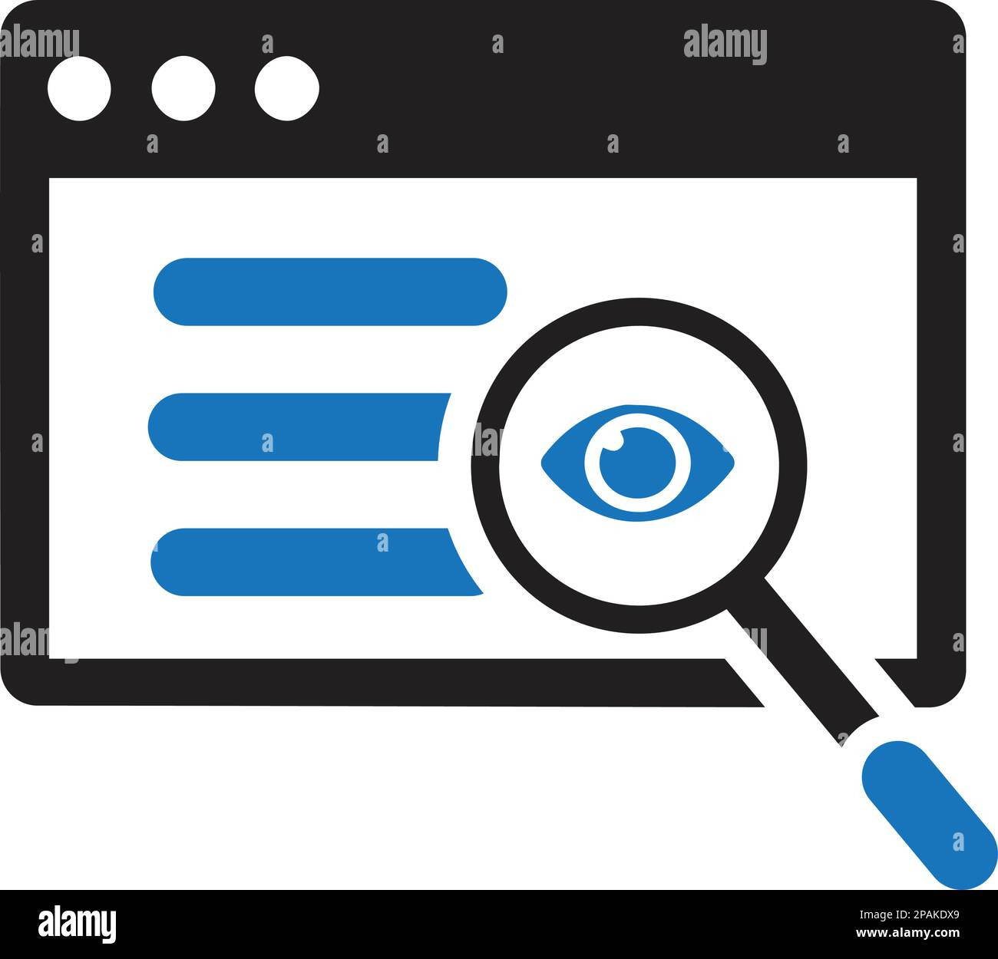

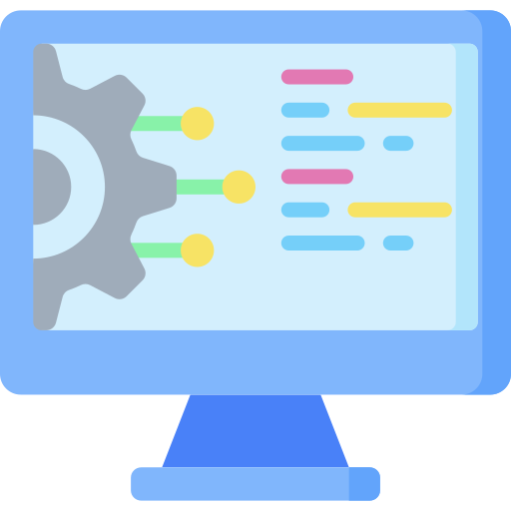


AGENDA
Assignment 1(a): Find five design issues with Everyday Things in terms of - Affordance, that is
1. Visibility | 2. Mappings | 3. System Image | 4. Gulf of Execution | 5. Gulf of Evaluation

Slide 3
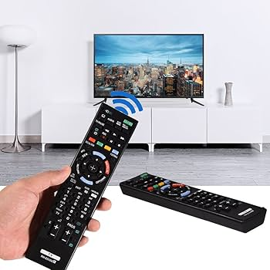
AFFORDANCE
Affordance refers to the design features of an object or interface that suggest its functionality and guide users on how to interact with it.
Fig 1: Example of Affordance

Slide 4
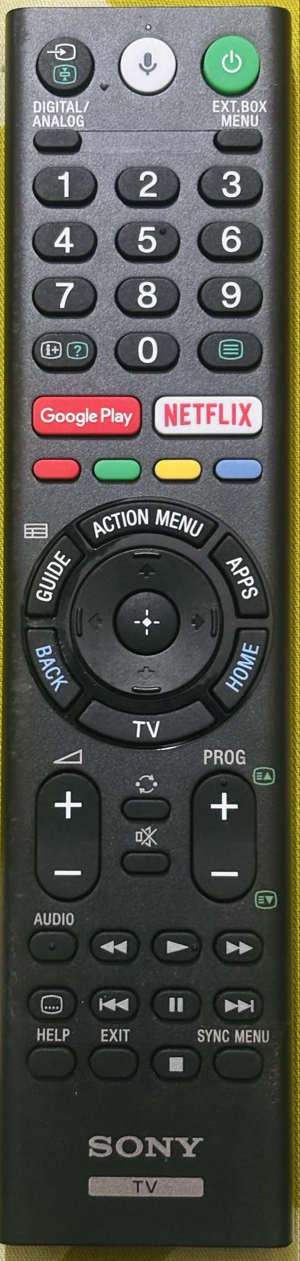
1. VISIBILITY
Visibility is basically a design principle that emphasizes making elements easily noticeable and recognizable to ensure they are effectively used.
Issue:
The remote has many buttons, some of which are not easily distinguishable. The small labels make it difficult to quickly identify their functions.
Impact:
Users may struggle to find the right button, especially in low lighting or if they are unfamiliar with the layout.
Fig 2: Example of Visibility Issue

Slide 5
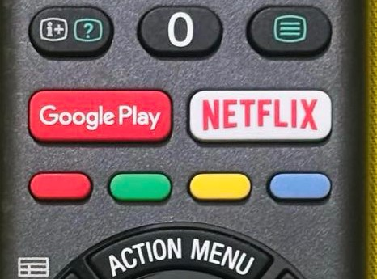
2. MAPPINGS
Mapping refers to the way controls are linked to their effects, creating a clear connection between user actions and outcomes. It helps align users’ expectations with the system’s behavior, making interactions intuitive and efficient.
Issue: Some buttons, such as the volume and channel controls, are well-placed, but others, like "Google Play" and "Netflix," might not be intuitive for users who expect standard TV controls.
Impact: Users might press the wrong button, thinking it controls something else, leading to frustration.
Fig 3: Example of Bad Mapping

Slide 6
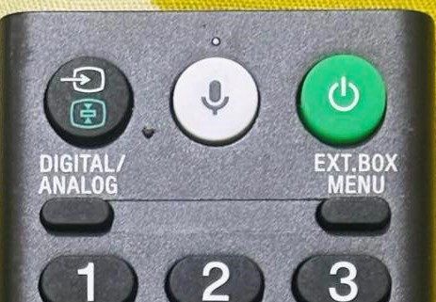
3. SYSTEM IMAGE
System Image refers to the way a product presents itself to users, including how its functions and controls are perceived based on its design, labels, instructions, and past experiences with similar products. It affects how easily users can understand and interact with a system.
Issue: The remote has buttons for digital/analog switching, external box menus, and a microphone, but there is no clear explanation of how they function.
Impact: Users may misunderstand how to navigate the TV system, leading to unnecessary trial and error.
Fig 4: Example of System Image Issue

Slide 7
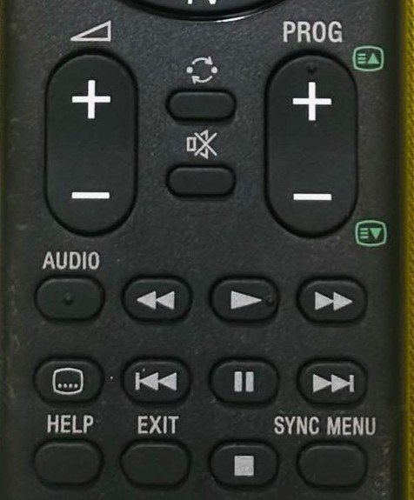
4. GULF OF EXECUTION
The Gulf of Execution refers to the gap between a user’s goal (what they want to do) and the system’s interface (how they can do it). It measures how easily a user can figure out the correct actions to achieve their goal.
Issue: Some actions, like switching between different input sources, require multiple button presses, but there is no clear guide on how to do it.
Impact: Users may struggle to perform the desired action because they don't know the correct sequence of button presses.
Fig 5: Example of Gulf of Execution Failure

Slide 8
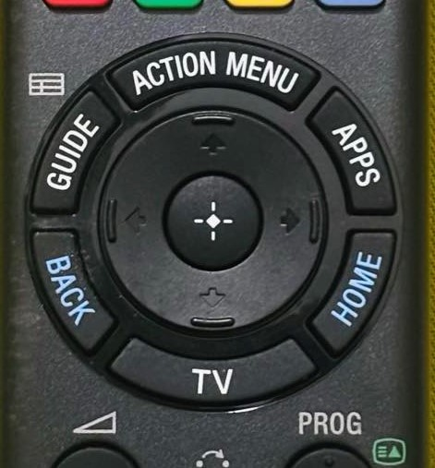
5. GULF OF EVALUATION
The Gulf of Evaluation refers to the gap between a user’s perception of the system’s state and the actual state of the system, making it difficult for the user to understand the results of their actions or feedback from the system.
Issue: Pressing a button may not always provide immediate feedback on whether the action was successful. For example, if a user presses the "Apps" button and nothing happens, they might not know if the TV is responding.
Impact: Users may press buttons repeatedly or assume the remote is malfunctioning when the system is just slow to respond.
Fig 6: Example of Gulf of Evaluation Issue

Slide 9
AGENDA
Assignment 1(b): Human Errors: Mention six slips occurred in your life
1. Leaving the fridge door open
2. Over-pouring a drink
3. Accidentally pressing the wrong button on an elevator
4. Forgetting to cover food on microwave oven
5. Accidentally setting the wrong cooking time on microwave oven
6. Putting your phone on silent and forgetting about it

Slide 10
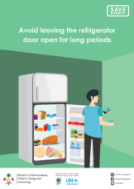
Human Errors:1ST SLIP
Leaving the fridge door open:
Example: I often close the fridge but forget to fully shut it, leaving it slightly ajar, which could spoil food or waste energy. This leads me to great danger, my mother’s wrath.
Fig 7: Leaving the fridge door open

Slide 11

Human Errors: 2ND SLIP
Over-pouring a drink:
Example: One of the most common slips of mine is that I pour myself a drink, but my attention slips, and I fill the glass too much, spilling some over the edge. Then I need to clean those water.
Figure 8: Over-pouring a drink

Slide 12

Human Errors: 3RD SLIP
Accidentally pressing the wrong button on an elevator:
Example: I accidentally press the wrong floor button while getting in an elevator, causing the elevator to stop at an unintended floor. And after that I ring the bell of that floor, assuming that is my home, and this often embarrass me.
Figure 9: Accidentally pressing the wrong button on an elevator

Slide 13
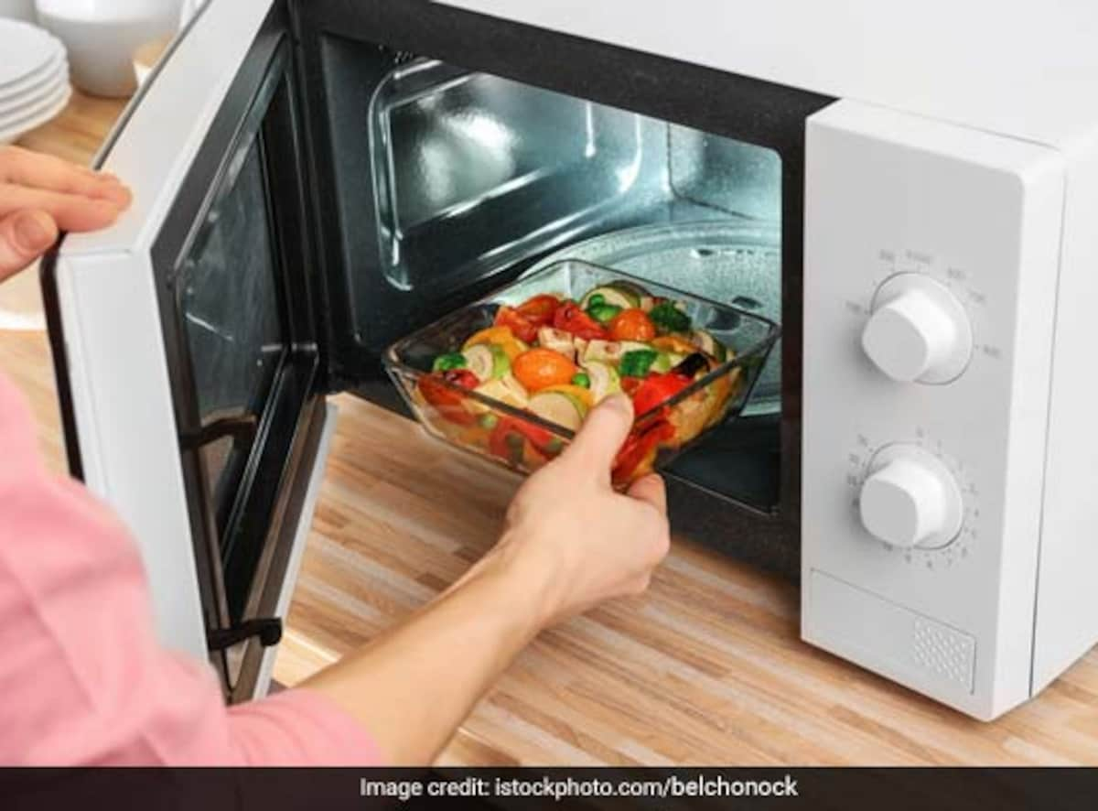
Human Errors: 4TH SLIP
Forgetting to cover food on microwave oven
Example: The main reason my mother doesn’t want me to use the microwave is that I often put my food in the microwave without covering it, which causes it to splatter inside the microwave, creating a mess and possibly making the food unevenly heated.
Figure 10: Forgetting to cover food on microwave oven

Slide 14
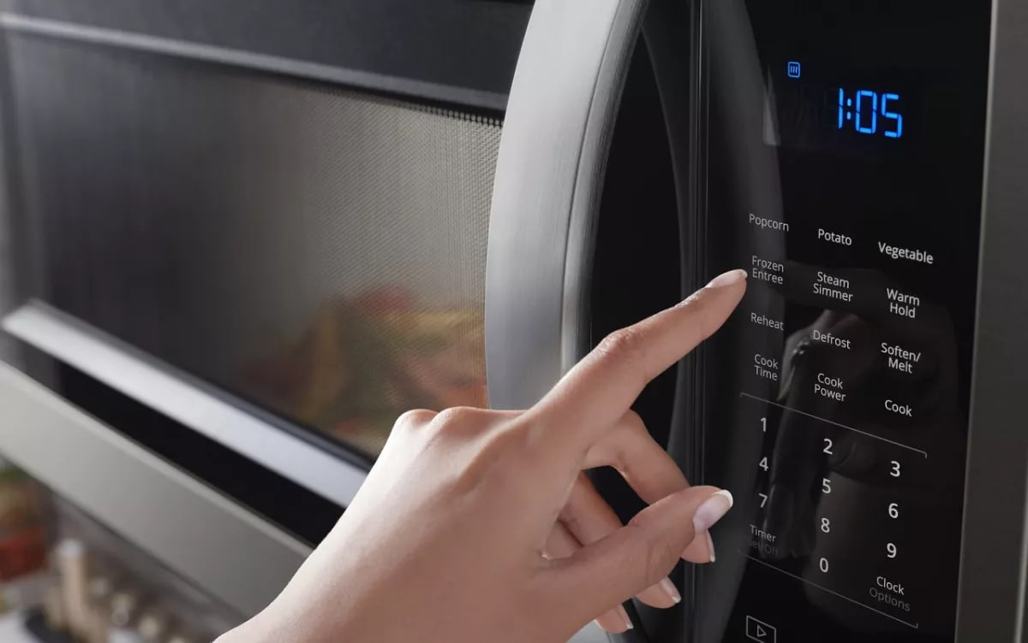
Human Errors: 5TH SLIP
Accidentally setting the wrong cooking time on microwave oven:
Example: I set the microwave to cook something for 2 minutes but accidentally press 20 minutes instead, leading to overcooking or burning your food. After what happen everyone knows(Between me and my mom!!!)
Figure 11: Accidentally setting the wrong cooking time on microwave oven

Slide 15
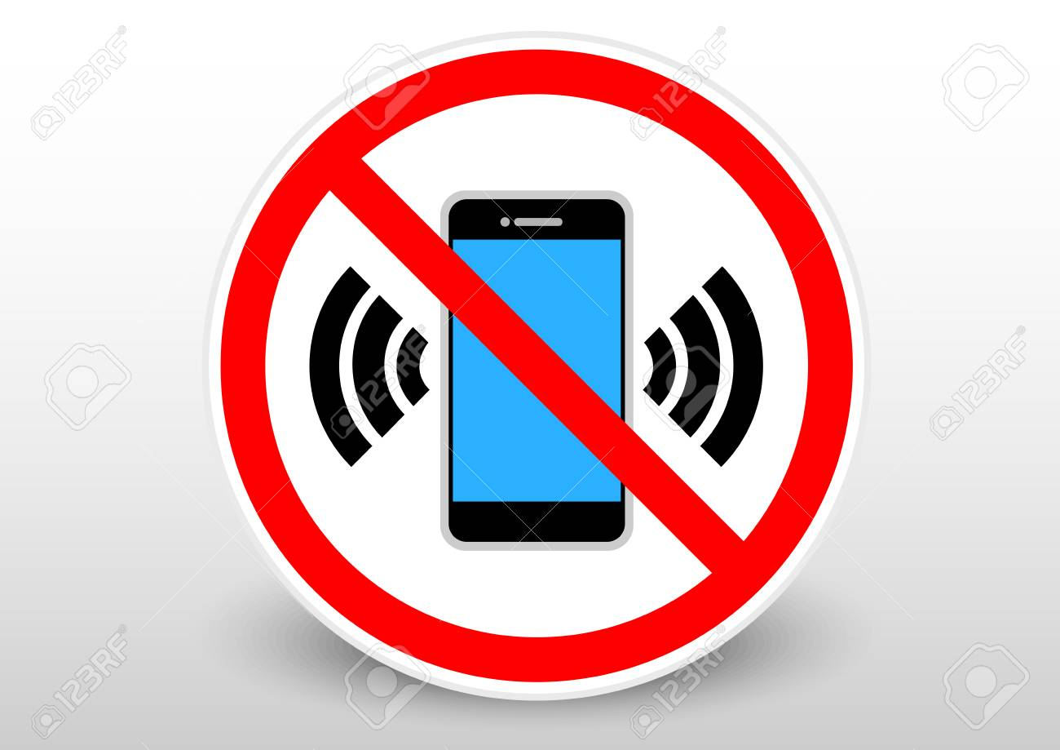
Human Errors: 6TH SLIP
Putting your phone on silent and forgetting about it:
Example: I often set my phone to silent for a meeting and forget to turn the sound back on, missing important calls or notifications.
Figure 12: Putting my phone on silent and forgetting about it

